Slide 1
Business Data Transformations – NYISO ETL Microsoft
Dr. Pawel Kalczynski

Slide 2
Introduction
The system was designed to:
Automatically extract data from NYISO (prices and demand, i.e., load)
Transform and load the data into a local database
Produce and evaluate forecasts (price and load)
Distribute the results via the Web
It was built with Microsoft Products and is running on Windows Server:
C# and J#
SQL Server Database
Microsoft Integration Services (MSIS)
Microsoft Analysis Services (MSAS)
Internet Information Services (IIS) and HTML
The purpose of this system is forecasting of electricity prices and load

Slide 3
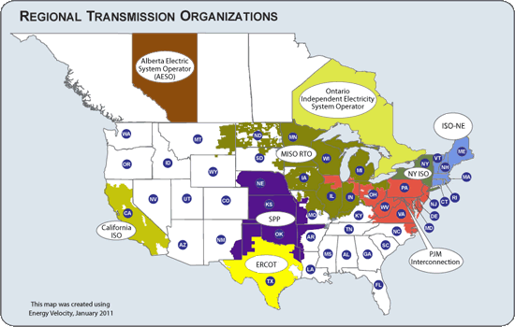
Electricity Markets

Slide 4
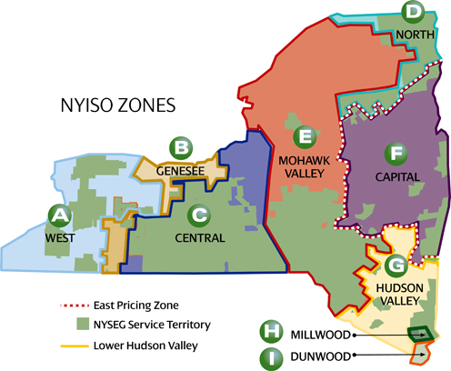
Introduction
NYISO Electricity Market
11 zones
500+ generators
Transmission lines

Slide 5
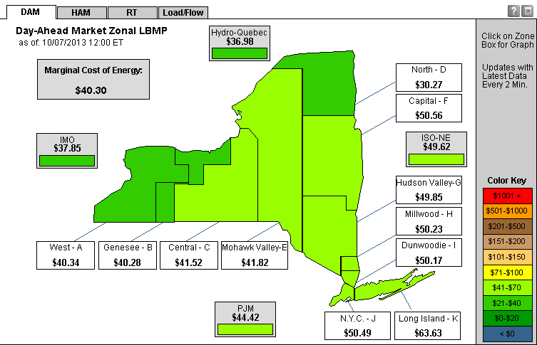
Locational Prices and Load

Slide 6
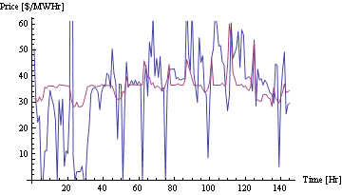
Two-Settlement Market - Prices
RTM
DAM
NYISO Reference Bus RTM and DAM Prices 1/1/2011-1/7/2011

Slide 7
NYISO Forecasting System
Consists of several independent services:
Data Extraction Service (DES)
Data Transformation Service (DTS)
Forecasting Service (FS)
Forecast Evaluation Service (FES)
Internet Presentation Service (IPS)

Slide 8
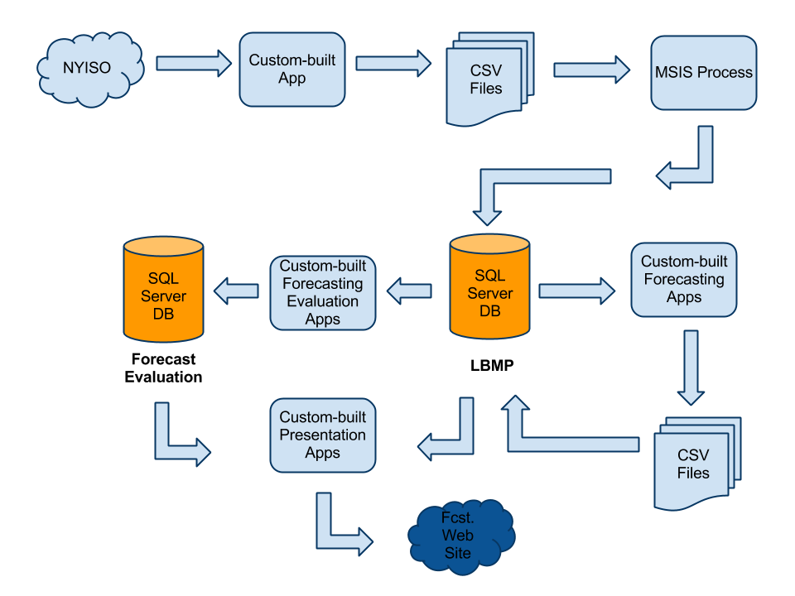
Forecasting System - Overview

Slide 9
Data Extraction Service
Custom-built in C#
Extracts raw data from the source
Stores raw data on the server
Launched every 5 minutes

Slide 10
Forecasting System - DES

Slide 11
Data Transformation Service
Microsoft Integration Services (MSIS)
Extracts raw data from local storage
Transforms (checks, cleanses, restructures) raw data
Loads transformed data into the data warehouse
Launched every 15 minutes

Slide 12
Forecasting System - DTS

Slide 13
Forecasting Service
Custom-built in C#
Reads data from the data warehouse
Handles null values
Applies multiple forecasting models (modularized)
Saves forecast data back into the data warehouse
Launched every 15 minutes

Slide 14
Forecasting System - FS

Slide 15
Forecast Evaluation Service
Custom-built in C#
Reads data from the data warehouse
Computes forecast evaluation metrics
Stores evaluation metrics in the designated database
Launched every hour

Slide 16
Forecasting System - FES

Slide 17
Internet Presentation Service
Custom-built in C#
Reads data from the data warehouse
Generates HTML code for static Web pages
Saves generated pages in the IIS published folder
Launched every 15 minutes

Slide 18
Forecasting System - IPS

